Slide 1
MSc Thesis Figures
Toy model plots (solved using Sundials cvode solver)
Dual control
Upstream repression
Downstream activation
Test results using Torch DiffEq (theta=1, dual control)
Allosteric repression
Upstream allostery of x1 on e1 only

Slide 2
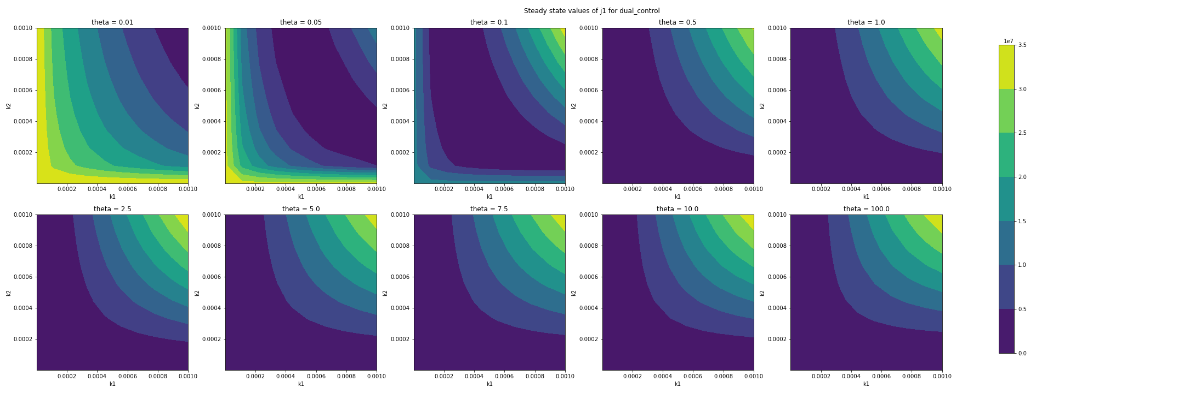
toy_model_sundials.ipynb

Slide 3
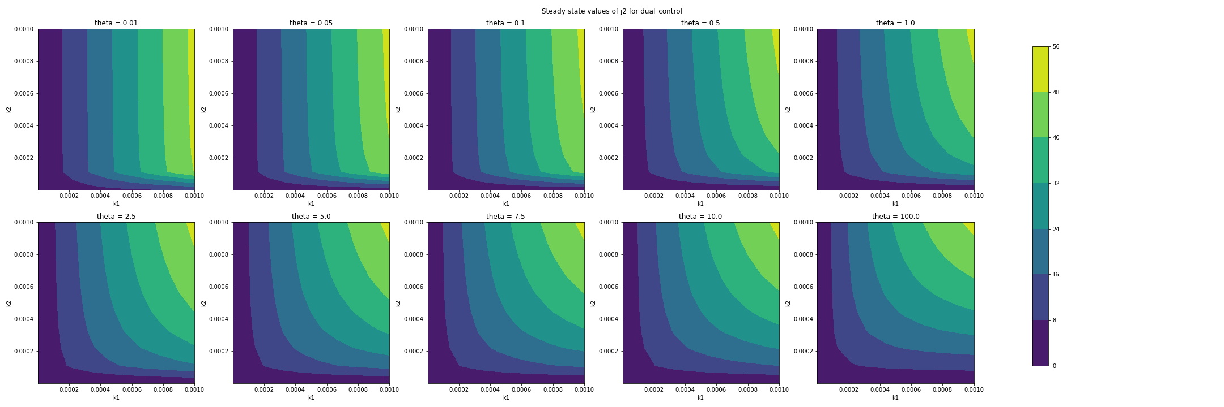
toy_model_sundials.ipynb

Slide 4
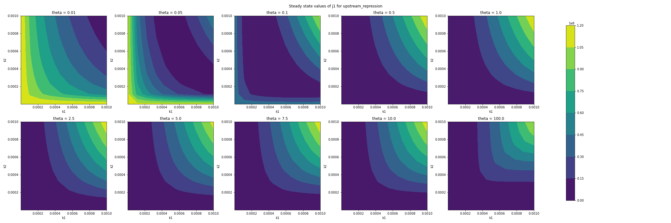
toy_model_sundials.ipynb

Slide 5
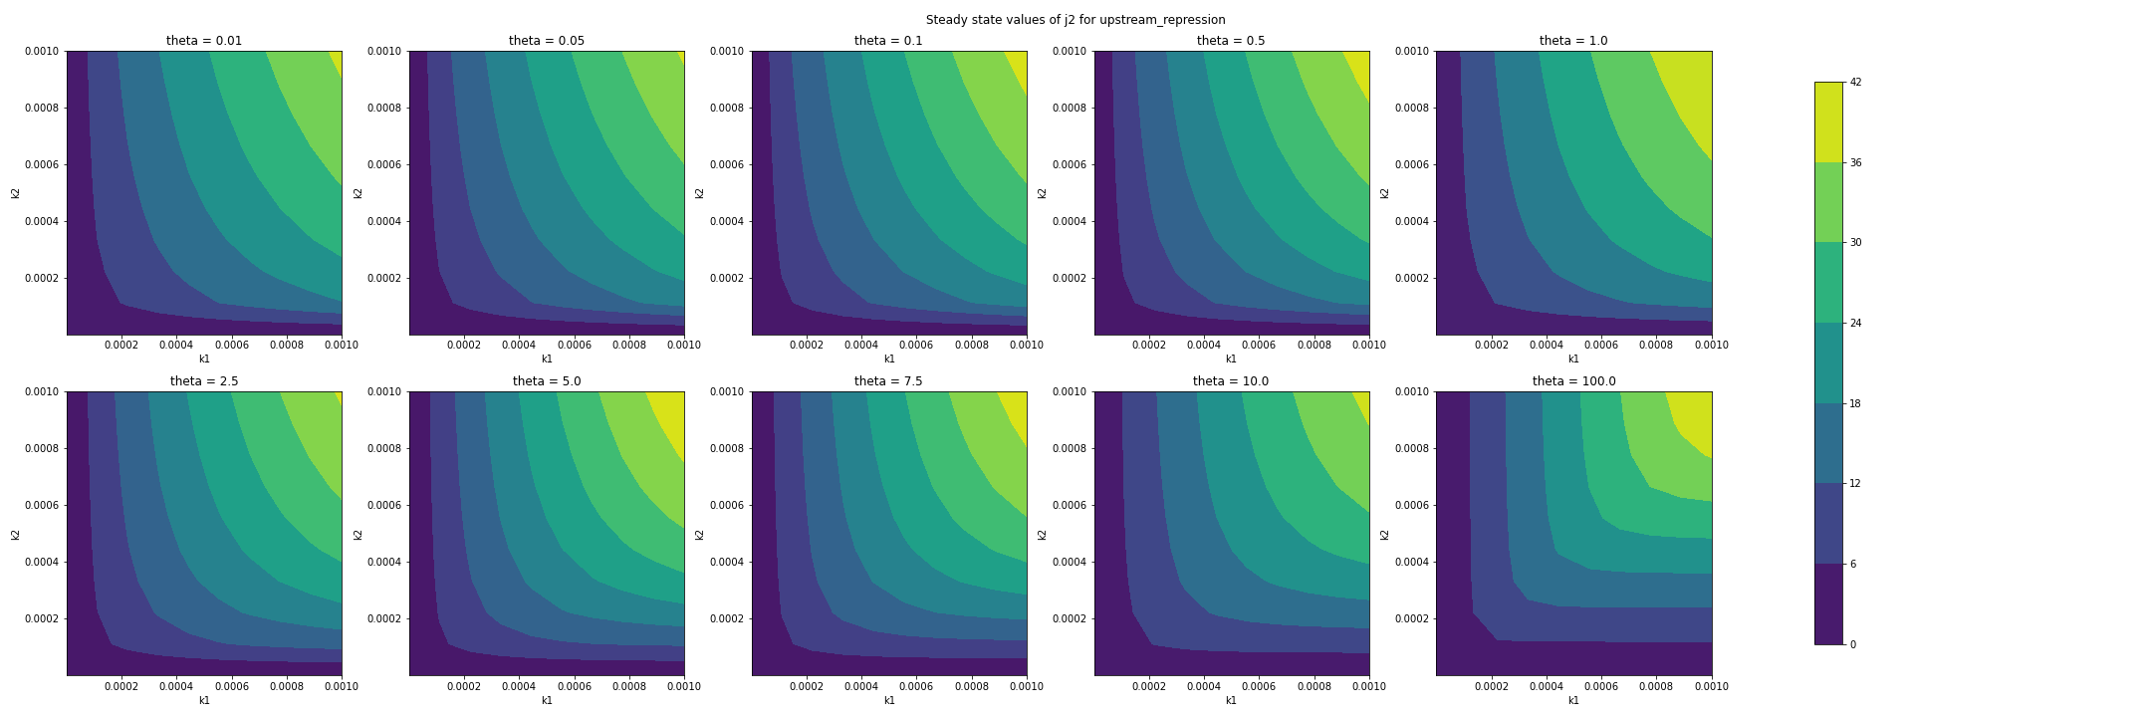
toy_model_sundials.ipynb

Slide 6
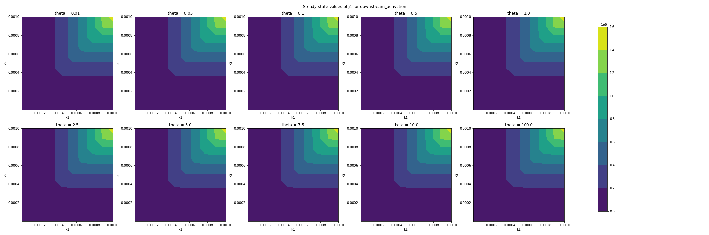
toy_model_sundials.ipynb

Slide 7
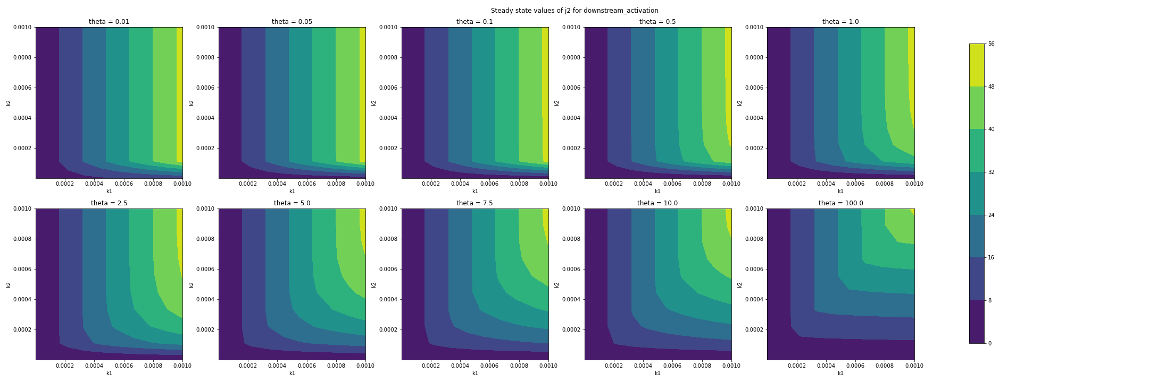
toy_model_sundials.ipynb

Slide 8
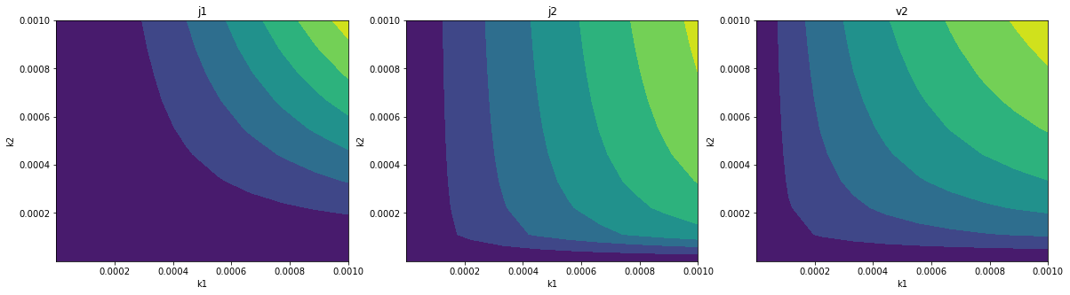
Torchdiffeq test results (took several hours to run): theta=1, dual control
torchdiffeq_test.ipnb

Slide 9
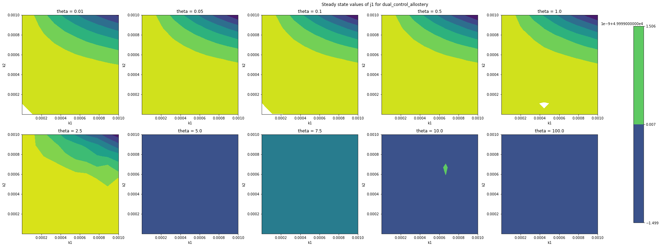
toy_model_sundials.ipynb

Slide 10
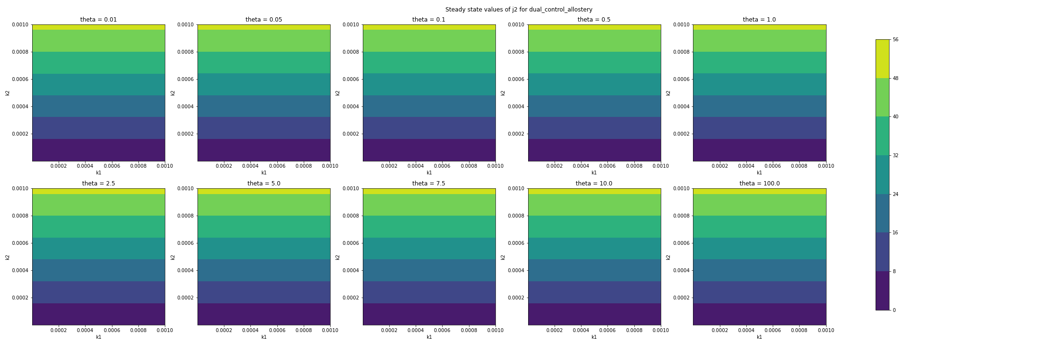
toy_model_sundials.ipynb

Slide 11
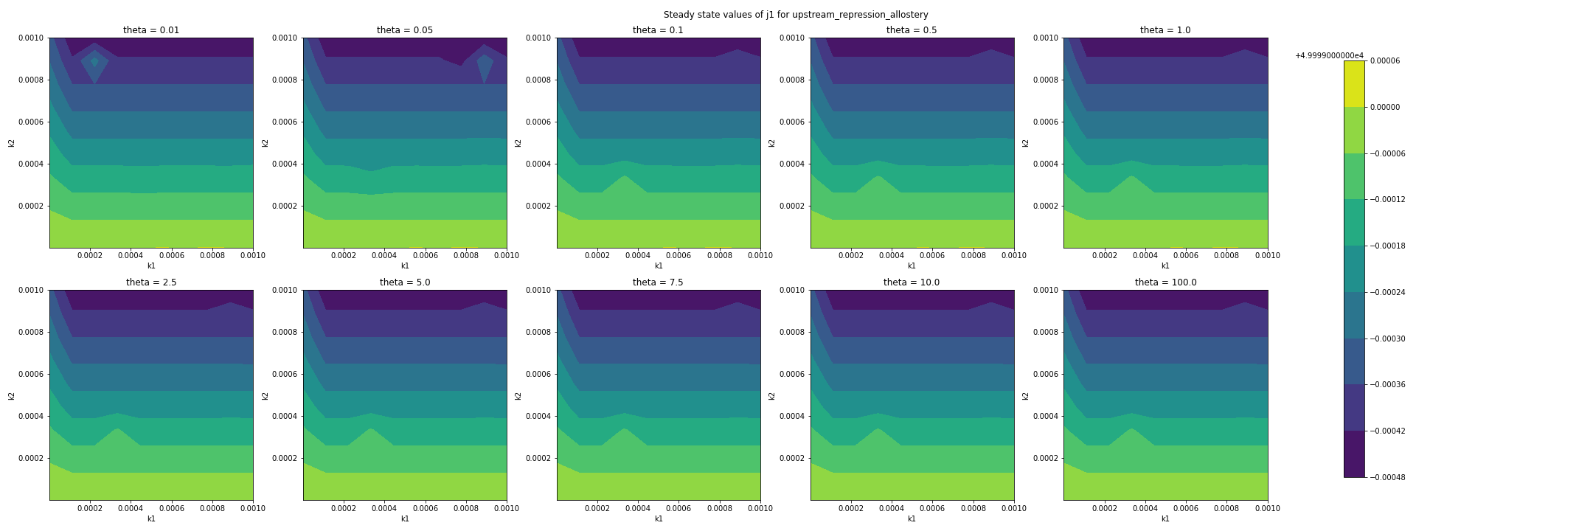
toy_model_sundials.ipynb

Slide 12

toy_model_sundials.ipynb

Slide 13
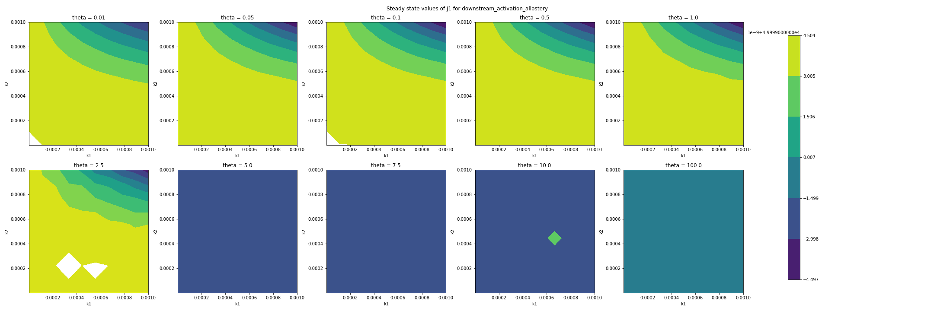
toy_model_sundials.ipynb

Slide 14
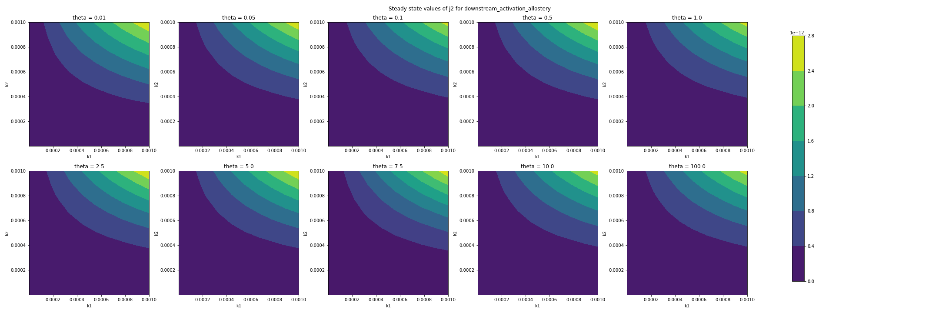
toy_model_sundials.ipynb

